Slide 1
UNIT-3

Slide 2
Topics to be covered in UNIT-3
Repetitive control structures – Pre-test and post-test loops, initialization and updation, event and counter controlled loops, while, do..while, for, break and continue statements, comma expression
Functions – User-defined functions, Function definition, arguments, return value, prototype, arguments and parameters, inner-function communication.
Standard functions – Math functions, Random numbers.
Scope – local, global.
Parameter passing – Call by value and call by reference.
Recursive functions – Definition, examples, advantages and disadvantages.
Macros – Definition, examples, comparison with functions.

Slide 3
Functions
Objectives
To design and implement programs with more than one function.
To understand the purpose of the function declaration, call, and definition.
To understand the four basic function designs.
To understand how two functions communicate through parameters.
To understand the differences between global and local scope.

Slide 4
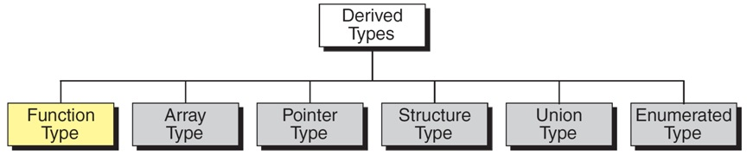
There are six derived types in C:
Functions ,Arrays, Pointer, Structure, Union and Enumerated Types.
Derived Types

Slide 5
Designing Structured Programs
The programs we have done so far have been very simple.
They solved problems that could be understood without too much effort.
The principles of top–down design and structured programming
dictate that a program should be divided into a main module and its
related modules.
Each module is in turn divided into sub-modules until the resulting
modules are intrinsic; that is, until they are implicitly understood
without further division.

Slide 6
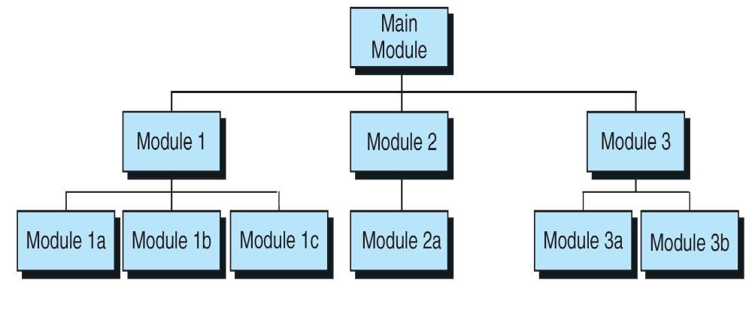
Top-down design is usually done using a visual representation of the
modules known as a structured chart.
Structure Chart

Slide 7
FUNCTIONS IN C
A function is a self-contained block of code that carries out some
specific and well-defined task.
In general, the purpose of a function is to receive zero or more pieces
of data, operate on them, and return at most one piece of data.
C functions are classified into two categories
1. Library Functions
2. User Defined Functions

Slide 8
FUNCTIONS IN C (contd…)
Library Functions:
These are the built in functions available in standard library of C.
The standard C library is collection of various types of functions which
perform some standard and predefined tasks.
Example:
abs (a) function gives the absolute value of a, available in <math.h>
pow (x, y) function computes x power y. available in <math.h>
printf () and scanf () performs I/O functions and etc..,

Slide 9
FUNCTIONS IN C (contd…)
User Defined Functions:
These functions are written by the programmer to perform some specific
tasks.
Example: main (), sum (), fact () , show(), display() and etc.,
The main distinction between these two categories is that library
functions are not required to be written by us whereas a user defined
function has to be developed by the user at the time of writing a
program.
Note:
In C, a program is made of one or more functions, one and only one of
which must be called main.
The execution of the program always starts with main, but it can call
other functions to do some part of the job.

Slide 10
Advantages of User-defined Functions
Modular Programming: It facilitates top down modular programming.
Reduction of Source Code: The length of the source program can be reduced by using functions at appropriate places.
Easier Debugging: It is easy to locate and isolate a faulty function for further investigation.
Code Reusability: A program can be used to avoid rewriting the same sequence of code at two or more locations in a program.
Function Sharing: Programming teams does a large percentage of programming. If the program is divided into subprograms, each subprogram can be written by one or two team members of the team rather than having the whole team to work on the complex program.

Slide 11
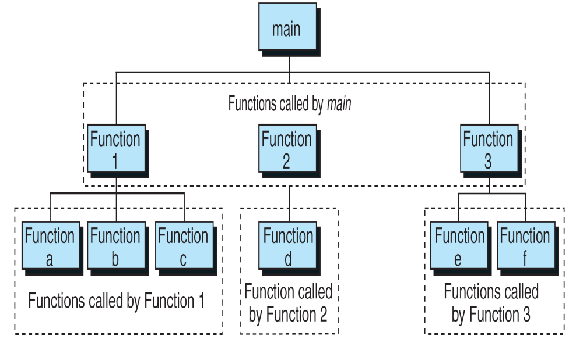
Structure Chart for a C Program

Slide 12
User-defined Functions
Like every other object in C, functions must be both declared and
defined.
The function declaration or prototype gives the whole picture of the
function that needs to be defined later.
The function definition contains the code for a function.
A function name is used three times in a C program: for declaration,
in a call, and for definition.

Slide 13
The general form of a C user-defined function:
return_type function_name (argument declaration) {
//local declarations
……
//statements
……
return (expression);
}

Slide 14
The general form of a C user-defined function (contd…)
return-type:
Specifies the type of value that a function returns using the return
statement.
It can be any valid data type.
If no data type is specified the function is assumed to return an integer
result.
function-name:
Must follow same rules of variable names in C.
No two functions have the same name in a C program.
argument declaration:
It is a comma-separated list of variables that receive the values of the
argument when function is called.
If there is no argument declaration the bracket consists of keyword void.

Slide 15
User-defined Functions (Contd…)
A function name is used three times in a C program: for declaration,
in a call, and for definition.
Function Declaration (or) Prototype:
The ANSI C standard expands the concept of forward function
declaration.
This expanded declaration is called a function prototype.
A function prototype performs two special tasks:
First it identifies the return type of the function so that the compile can
generate the correct code for the return data.
Second, it specifies the type and number of arguments used by the
function.
Note: The prototype normally goes near the top of the program and must appear before any call is made to the function.

Slide 16
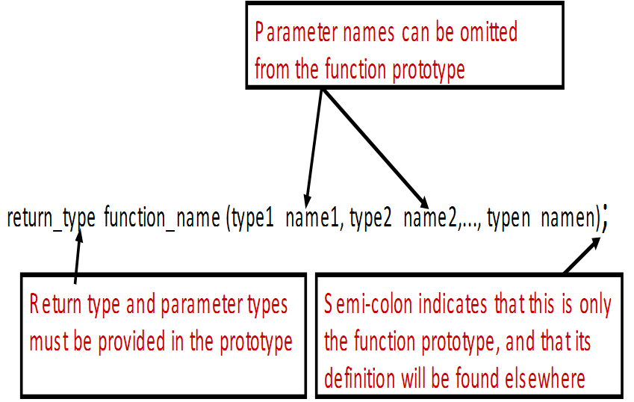
User-defined Functions (Contd…)
The general form of the function prototype or declaration is:

Slide 17
User-defined Functions (Contd…)
User-defined Functions (Contd…)
The Function Call:
A function call is a postfix expression.
The operand in a function is the function name.
The operator is the parameter lists (…), which contain the actual
parameters.
Example:
void main ()
{
sum (a, b);
}
When the compiler encounters the function call ,the control is transferred
to the function sum().
The function is executed line by line and produces the output for the sum
of two numbers and then control is transferred back to the main function.

Slide 18
User-defined Functions (Contd…)
Function Definition: The function definition contains the code for a function.
It is made up of two parts:
The function header and the function body, the compound statement
is must.
Function header consists of three parts:
    the return type,
    the function name, and
    the formal parameter list.
Function body contains local declarations and function statement.
Variables can be declared inside function body.
Function can not be defined inside another function.

Slide 19
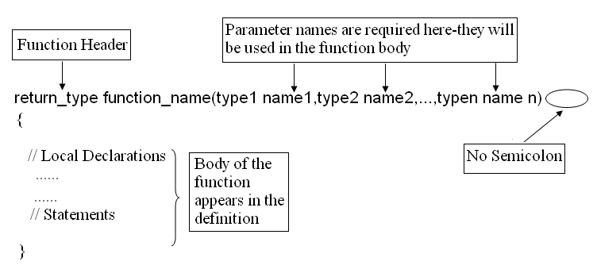
User-defined Functions (Contd…)
Function Definition

Slide 20
User-defined Functions (Contd…)
Category of User –Defined Functions:
A function, depending on whether arguments are present or not and whether a value is returned or not, may belong to one of the following categories:
Category 1: Functions with no arguments and no return values
Category 2: Functions with no arguments and return values
Category 3: Functions with arguments and no return values
Category 4: Functions with arguments and return values

Slide 21
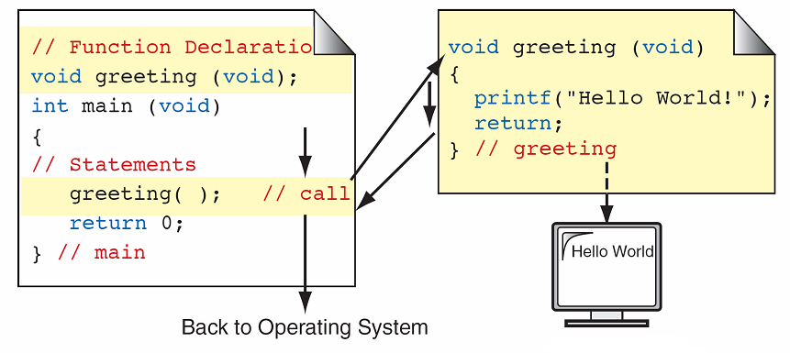
User-defined Functions (Contd…)
1. Functions with no arguments and no return values:
This type of function has no arguments, meaning that it does not
receive any data from the calling function.
Similarly function does not return any value.
In the figure, the function greeting () do not receive any values from the
function main () and it does not return any value to the function main ().
Observe the transfer of control between the functions indicated with arrows.

Slide 22
User-defined Functions (Contd…)
/*Example for Functions with no arguments and no return values
to print addition of sum of two numbers*/
#include<stdio.h>
void sum(); /* function prototype */
void main()
{
sum (); /* function calling*/
}
void sum () /* Function Definition */
{
int x, y, z;
printf (“\n Enter the values of x and y: “);
scanf (“%d%d”, &x, &y);
z=x+y;
printf (“\n The sum = %d”,z);
}

Slide 23
User-defined Functions (Contd…)
2. Functions with no arguments and return values:
Generally, there are two ways that a function terminates execution and
returns to the caller.
When the last statement in the function has executed and conceptually
the function’s ending ‘}’ is encountered.
Whenever it faces return statement.
The return statement: It is the mechanism for returning a value from the called function to its caller.
The general form of the return statement is:
return expression;

Slide 24
Functions with no arguments and return values (Contd…)
The calling function is free to ignore the returned value.
Expression after the return is not necessary.
The return statement has two important uses:
It causes an immediate exit of the control from the function. That is ,it causes program execution to return to the called function.
It returns the value present in the expression.
Example: return(x + y);
return (6 * 8);
return (3);
return;

Slide 25
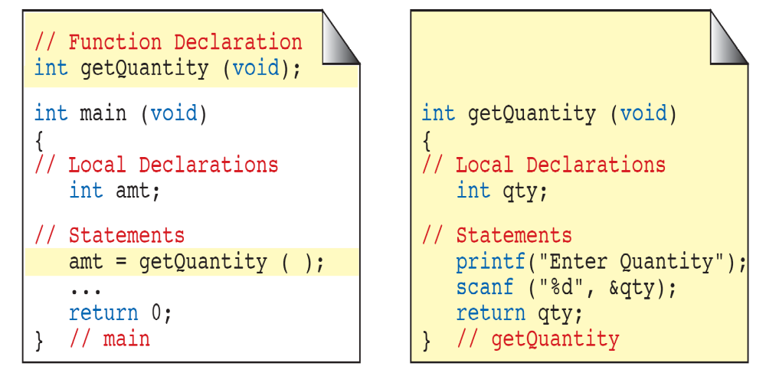
Functions with no arguments and return values (Contd…)
In this category, there is no data transfer from the calling function to the called
function. But, there is data transfer from called function to the calling function.
In the above Figure, observe that the function getQuantity () do not receive any
value from the function main ().But, it accepts data from the keyboard, and
returns the value to the calling function.

Slide 26
User-defined Functions (Contd…)
/*Example for Functions with no arguments and return values
to print addition of sum of two numbers*/
#include<stdio.h>
int sum(); /* function prototype */
int main()
{
int c;
c = sum(); /*function calling */
printf (“\n The sum = %d”, c);
}
int sum () /* Function Definition */
{
int x, y;
printf (“\n Enter the values of x and y: “);
scanf (“%d%d”, &x, &y);
/* return value to the calling function */
return x+y;
}

Slide 27
User-defined Functions (Contd…)
3. Functions with arguments and no return values:
In this category there is data transfer from the calling function to the
called function using parameters.
But, there is no data transfer from called function to the calling
function.
Local Variables:
Variables that are defined within a function are called local variables.
A local variable comes into existence when the function is entered and
is destroyed upon exit.
Function Arguments: The arguments that are supplied to function are in two categories
1. Actual Arguments/Parameters
2. Formal Arguments/Parameters

Slide 28
User-defined Functions (Contd…)
Functions with arguments and no return values (Contd…)
Actual Arguments/Parameters:
Actual parameters are the expressions in the calling functions.
These are the parameters present in the calling statement (function
call).
Formal Arguments/Parameters:
Formal parameters are the variables that are declared in the header of
the function definition.
Note: Actual and Formal parameters must match exactly in type, order, and number. Their names however, do not need to match.

Slide 29
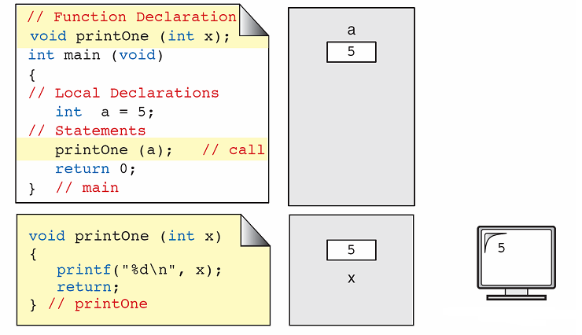
User-defined Functions (Contd…)
Functions with arguments and no return values (Contd…)
Observe from the above figure, the function printOne () receives one value from the function main (), display the value copy of a.

Slide 30
User-defined Functions (Contd…)
/*Example for Functions with arguments and no return values
to print addition of sum of two numbers*/
#include<stdio.h>
void sum(int,int); /* function prototype */
void main ()
{
int a, b;
printf (“\n Enter the values of a and b: “);
scanf (“%d%d”, &a, &b);
sum (a, b); /*calling function */
}
void sum (int x, int y) /* function definition */
{
int z;
z=x+y;
printf (“\n The Sum =%d”, z);
}

Slide 31
User-defined Functions (Contd…)
Passing Parameters to Functions: There are two ways of passing parameters to the functions.
1. Call by value and 2. Call by reference
Call by value:
When a function is called with actual parameters, the values of actual
parameters are copied into the formal parameters.
If the values of the formal parameters changes in the function, the values of
the actual parameters are not changed.
This way of passing parameters is called call by value (pass by value).
In the below example, the values of the arguments to swap () 10 and 20 are
copied into the parameters x and y.
Note that the values of x and y are swapped in the function.
But, the values of actual parameters remain same before swap and after swap.
Note: In call by value any changes done on the formal parameter will not affect the actual parameters.

Slide 32
User-defined Functions (Contd…)
/*Example for Functions with arguments and no return values
to swap two numbers*/
#include<stdio.h>
void swap (int , int ); /*function prototype */
void main ()
{
int a, b;
printf (“\n Enter the values of a and b: “);
scanf (“%d%d”, &a, &b);
swap (a, b); /*function calling*/
printf (“\nFrom main The Values of a and b a=%d, b=%d “, a, b);
}
void swap (int x, int y) /* function definition */
{
int temp;
temp=x;
x=y;
y=temp;
printf (“\n The Values of a and b after swapping a=%d, b =%d”, x, y);
}

Slide 33
User-defined Functions (Contd…)
4. Functions with arguments and return values:
In this category there is data transfer between the calling function and
called function.
Observe from the above figure, the function sqrt() receive one value from the function main (), finds the square of the number and sends the result back to the calling function.

Slide 34
User-defined Functions (Contd…)
/*Example for Functions with arguments and return values
to swap two numbers*/
#include<stdio.h>
int swap (int , int ); /*function prototype*/
void main()
{
int a,b;
printf (“\n Enter the values of a and b: “);
scanf (“%d%d”, &a, &b);
c = sum (a, b); /*calling function */
printf (“\n The Sum =%d”, c);
}
int sum (int x, int y) /* Function definition */
{
int z;
return x+y;
}

Slide 35
Parts of a Function Call

Slide 36
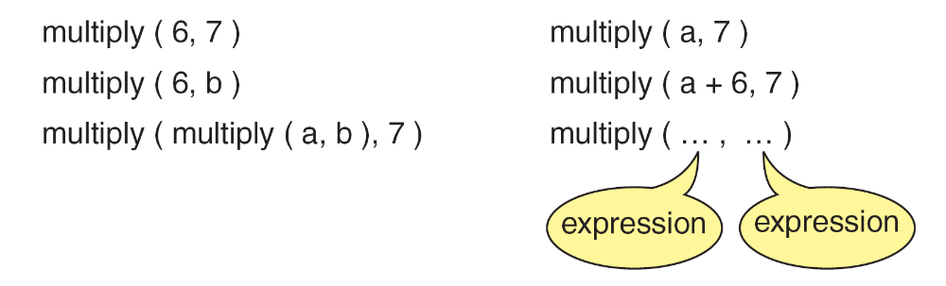
Examples of Function Calls

Slide 37
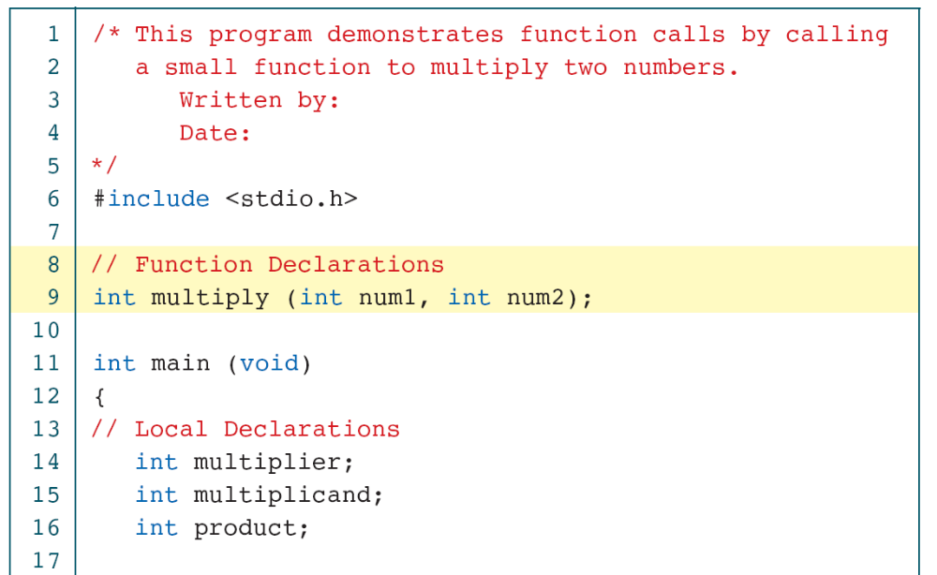
Sample Program with Subfunction

Slide 38
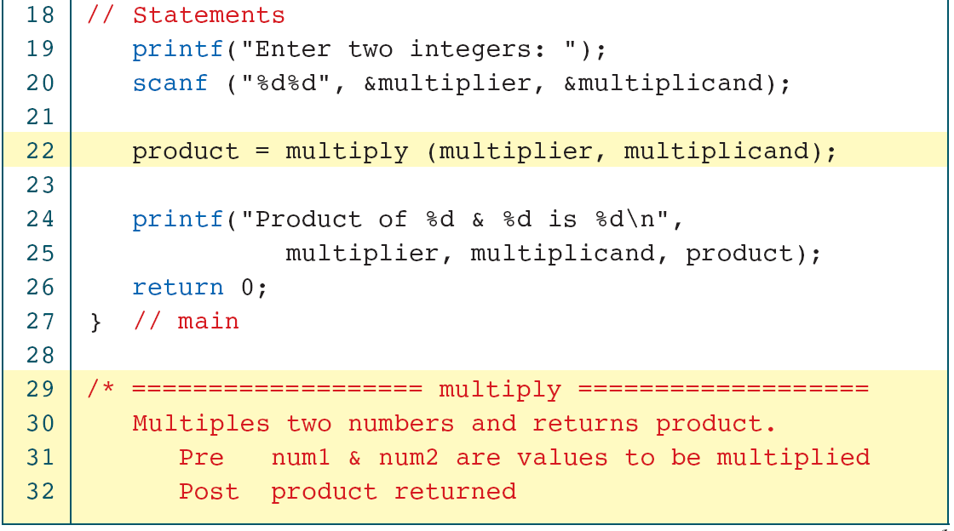
Sample Program with Subfunction

Slide 39
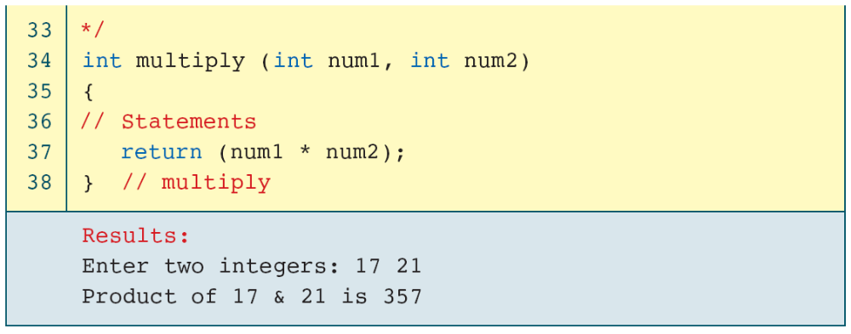
Sample Program with Subfunction

Slide 40
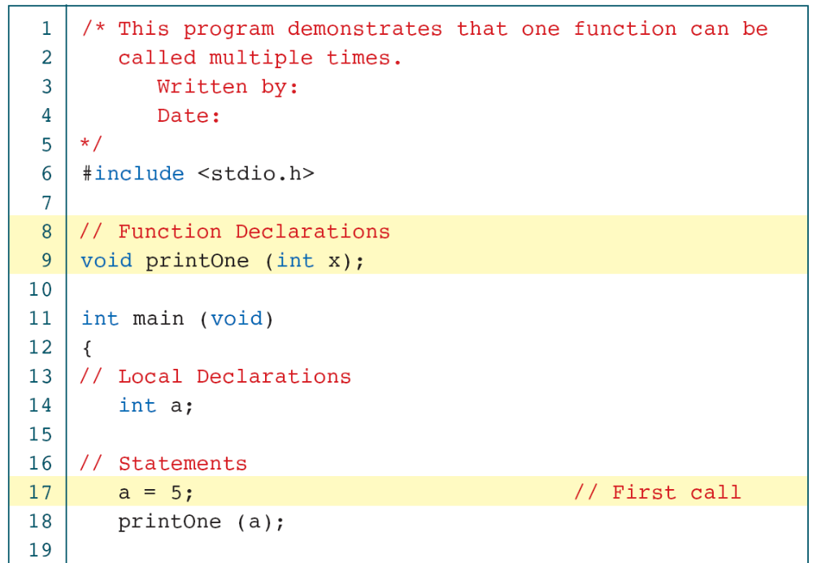
void Function with a Parameter

Slide 41
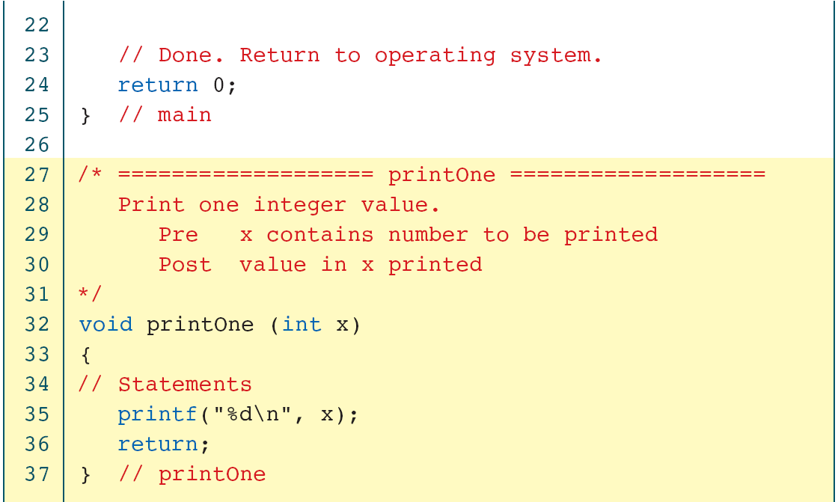
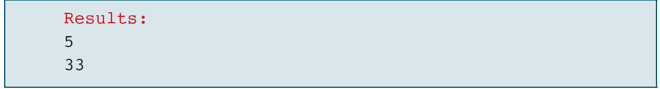
void Function with a Parameter

Slide 42
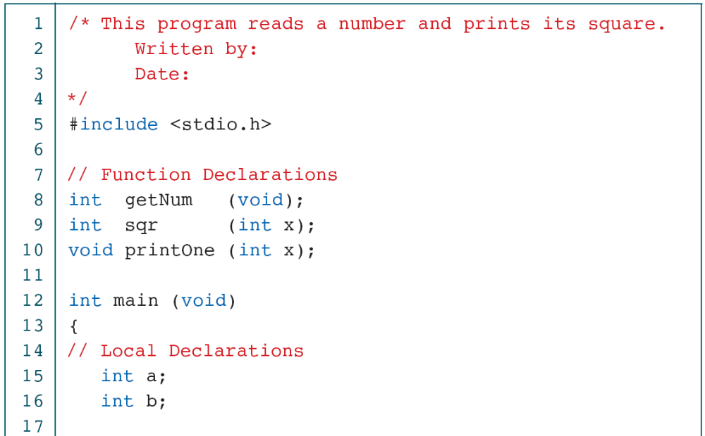
Read a Number and Square It

Slide 43
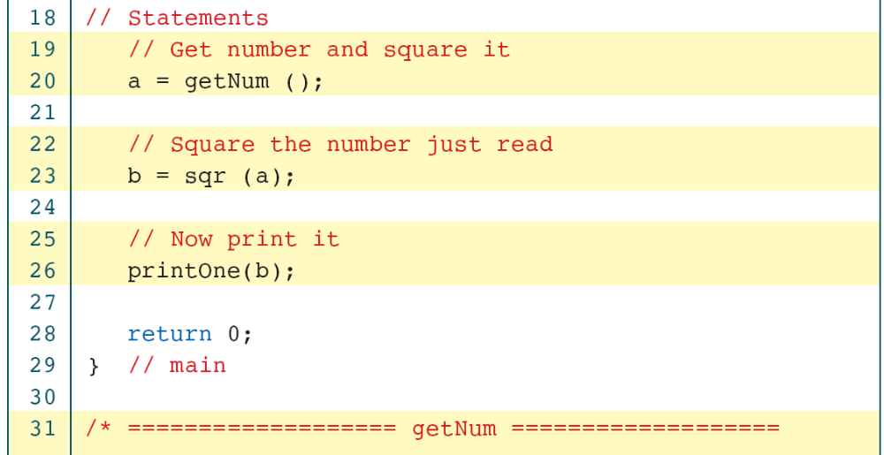
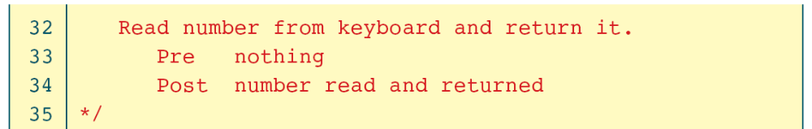
Read a Number and Square It

Slide 44
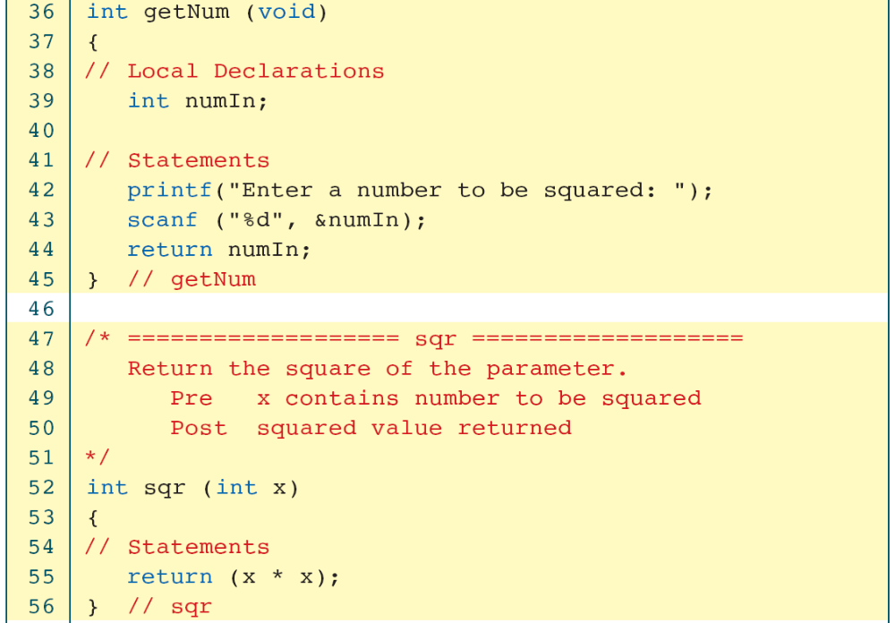
Read a Number and Square It

Slide 45
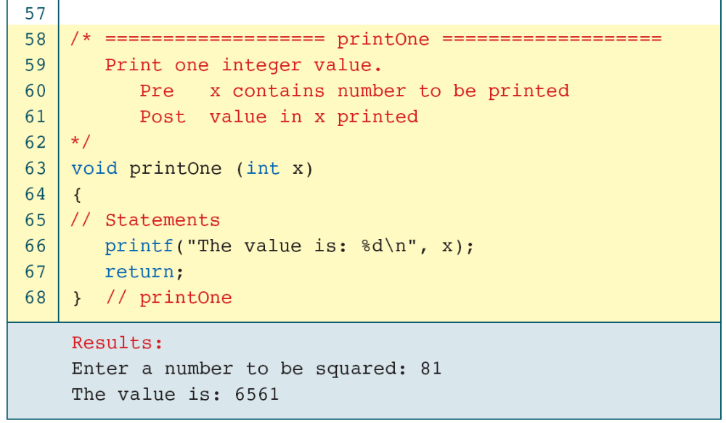
Read a Number and Square It

Slide 46
Nesting of functions
C permits nesting of functions, main function can call function1, function1 can call function2, which in turn calls function3 ..,
There is no limit as how deeply functions can be nested.
Consider the following example:
In the below example ,when the main() function finds the function call sum(), then the control is transferred from main() to the function sum(), there sum() is calling the function read(), then the control is transferred to read() function, then the body of the function read() executes, then the control is transferred back to sum(). Again read() function is invoked.
Observe the chain of control transfers between the nested functions.

Slide 47
#include<stdio.h> //Example program for nested-functions
int read ();
int sum (int, in t);
void main ()
{
int a, b;
printf (“%d”, sum (a,b));
}
int sum (int x, int y)
{
x=read ();
y=read ();
return x + y;
}
int read ()
{
int p;
printf (“\n Enter any value: “);
scanf (“%d”, &p);
return p;
}

